Slide 1

Chapter 3 Memory Management
Tanenbaum, Modern Operating Systems 3 e, (c) 2008 Prentice-Hall, Inc. All rights reserved. 0-13-6006639

Slide 2
Virtual Memory-the history
Keep multiple parts of programs in memory
Swapping is too slow (100 Mbytes/sec disk transfer rate=>10 sec to swap out a 1 Gbyte program)
Overlays-programmer breaks program into pieces which are swapped in by overlay manager
Ancient idea-not really done
Too hard to do-programmer has to break up program
Tanenbaum, Modern Operating Systems 3 e, (c) 2008 Prentice-Hall, Inc. All rights reserved. 0-13-6006639

Slide 3
Virtual Memory
Program’s address space is broken up into fixed size pages
Pages are mapped to physical memory
If instruction refers to a page in memory, fine
Otherwise OS gets the page, reads it in, and re-starts the instruction
While page is being read in, another process gets the CPU
Tanenbaum, Modern Operating Systems 3 e, (c) 2008 Prentice-Hall, Inc. All rights reserved. 0-13-6006639

Slide 4
Memory Management Unit
Memory Management Unit generates physical address from virtual address provided by the program
Tanenbaum, Modern Operating Systems 3 e, (c) 2008 Prentice-Hall, Inc. All rights reserved. 0-13-6006639

Slide 5
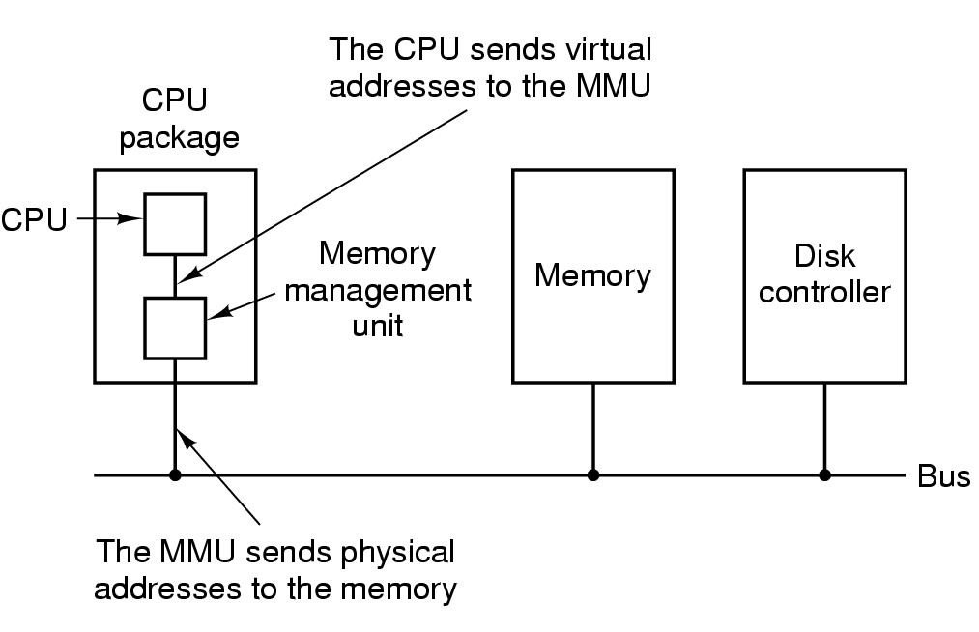
Memory Management Unit
MMU maps virtual addresses to physical addresses and puts them on memory bus
Tanenbaum, Modern Operating Systems 3 e, (c) 2008 Prentice-Hall, Inc. All rights reserved. 0-13-6006639

Slide 6
Pages and Page Frames
Virtual addresses divided into pages
512 bytes-64 KB range
Transfer between RAM and disk is in whole pages
Example on next slide
Tanenbaum, Modern Operating Systems 3 e, (c) 2008 Prentice-Hall, Inc. All rights reserved. 0-13-6006639

Slide 7
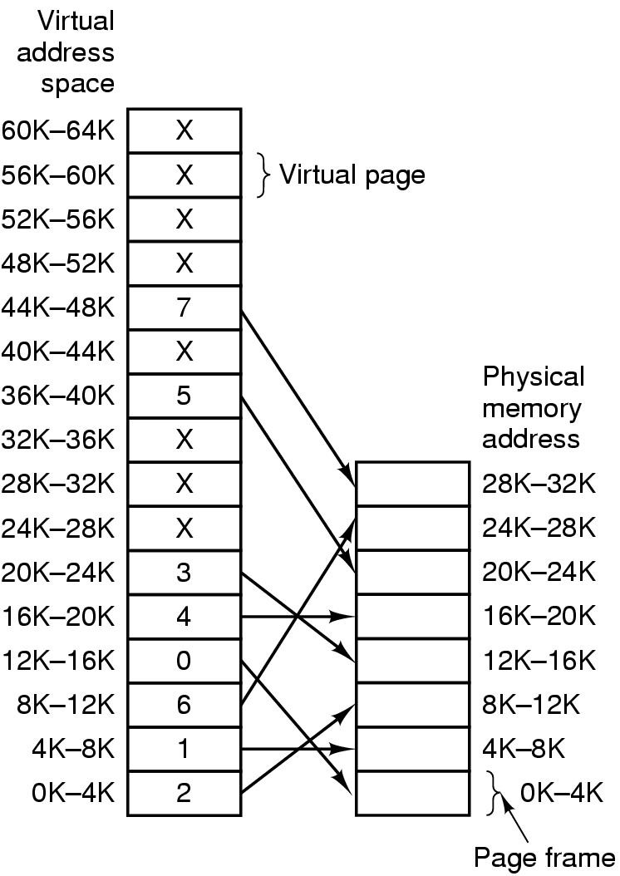
Mapping of pages to page frames
16 bit addresses, 4 KB pages
32 KB physical memory,
16 virtual pages and 8 page frames
Tanenbaum, Modern Operating Systems 3 e, (c) 2008 Prentice-Hall, Inc. All rights reserved. 0-13-6006639

Slide 8
Page Fault Processing
Present/absent bit tells whether page is in memory
What happens If address is not in memory?
Trap to the OS
OS picks page to write to disk
Brings page with (needed) address into memory
Re-starts instruction
Tanenbaum, Modern Operating Systems 3 e, (c) 2008 Prentice-Hall, Inc. All rights reserved. 0-13-6006639

Slide 9
Page Table
Virtual address={virtual page number, offset}
Virtual page number used to index into page table to find page frame number
If present/absent bit is set to 1, attach page frame number to the front of the offset, creating the physical address
which is sent on the memory bus
Tanenbaum, Modern Operating Systems 3 e, (c) 2008 Prentice-Hall, Inc. All rights reserved. 0-13-6006639

Slide 10
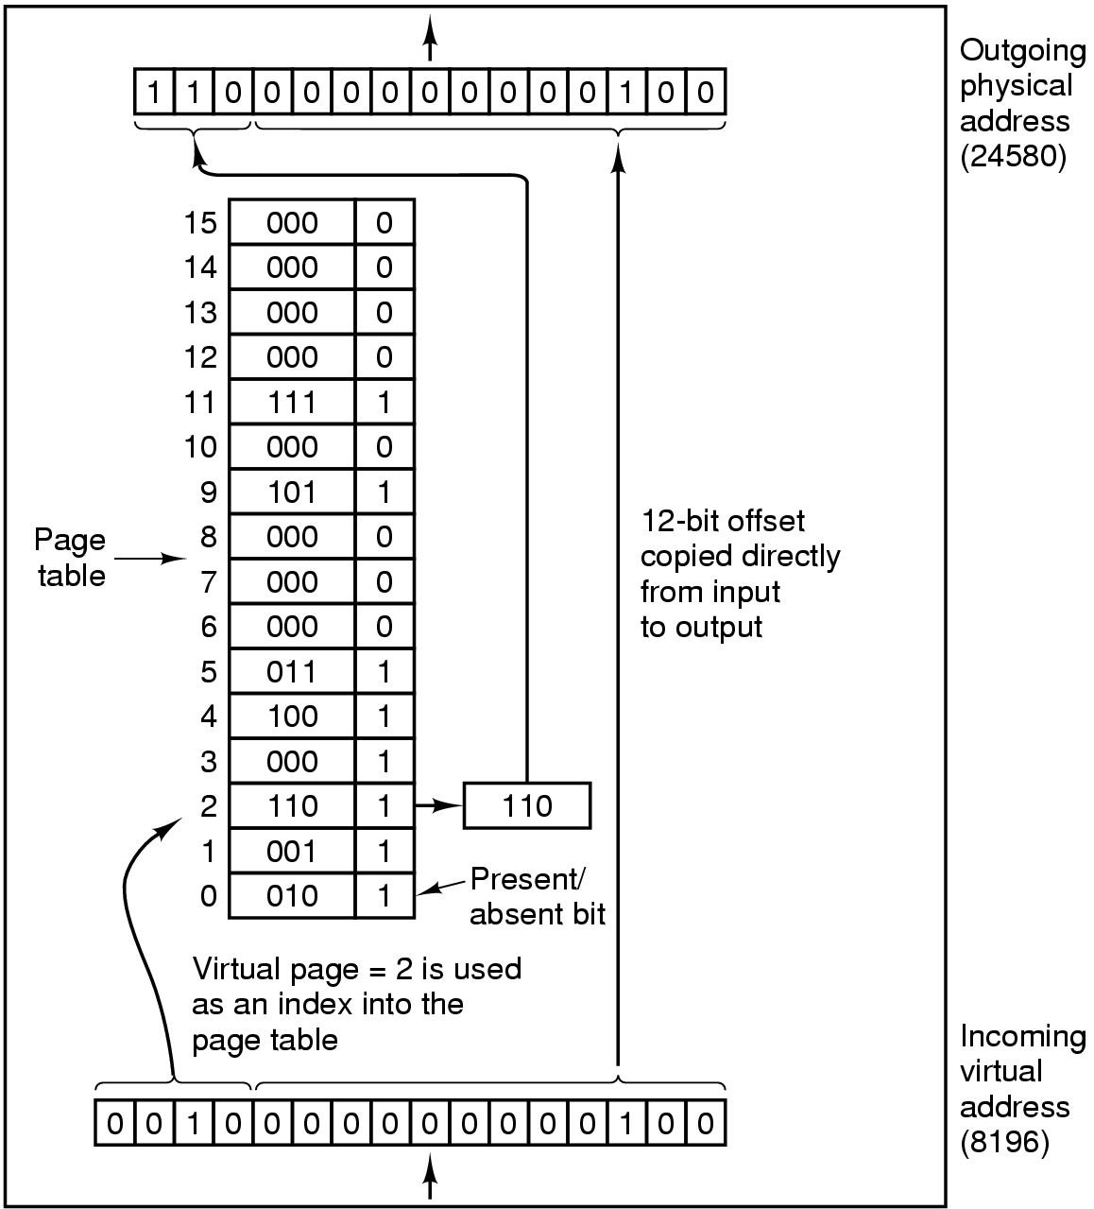
MMU operation
Tanenbaum, Modern Operating Systems 3 e, (c) 2008 Prentice-Hall, Inc. All rights reserved. 0-13-6006639

Slide 11
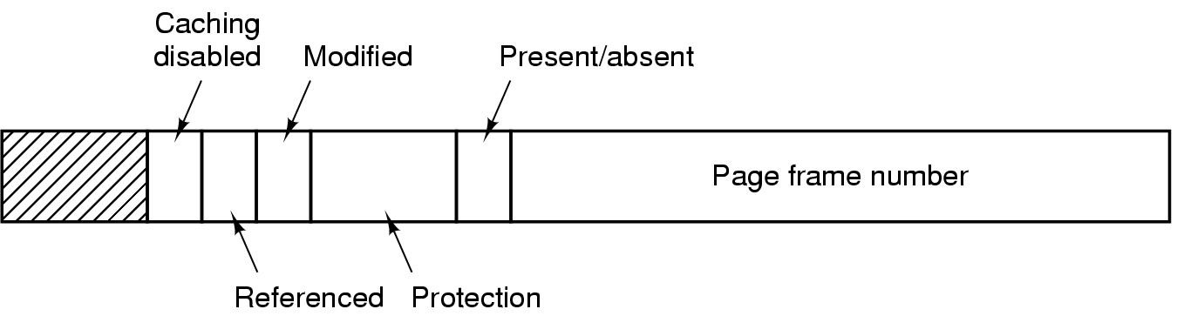
Structure of Page Table Entry
Modified (dirty) bit: 1 means written to => have to write it to disk. 0 means don’t have to write to disk.
Referenced bit: 1 means it was either read or written. Used to pick page to evict. Don’t want to get rid of page which is being used.
Present (1) / Absent (0) bit
Protection bits: r, w, r/w
.
Tanenbaum, Modern Operating Systems 3 e, (c) 2008 Prentice-Hall, Inc. All rights reserved. 0-13-6006639

Slide 12
Problems for paging
Virtual to physical mapping is done on every memory reference => mapping must be fast
If the virtual address space is large, the page table will be large. 32 bit addresses now and 64 bits becoming more common
Tanenbaum, Modern Operating Systems 3 e, (c) 2008 Prentice-Hall, Inc. All rights reserved. 0-13-6006639

Slide 13
Stupid solutions
Bring page table for a process into MMU when it is started up and store it in registers
Keep page table in main memory
Tanenbaum, Modern Operating Systems 3 e, (c) 2008 Prentice-Hall, Inc. All rights reserved. 0-13-6006639

Slide 14
Speed up Address Translation
Most programs access a small number of pages a great deal
Add Translation Lookaside Buffer (TLB) to MMU
Stores frequently accessed frames
Tanenbaum, Modern Operating Systems 3 e, (c) 2008 Prentice-Hall, Inc. All rights reserved. 0-13-6006639

Slide 15
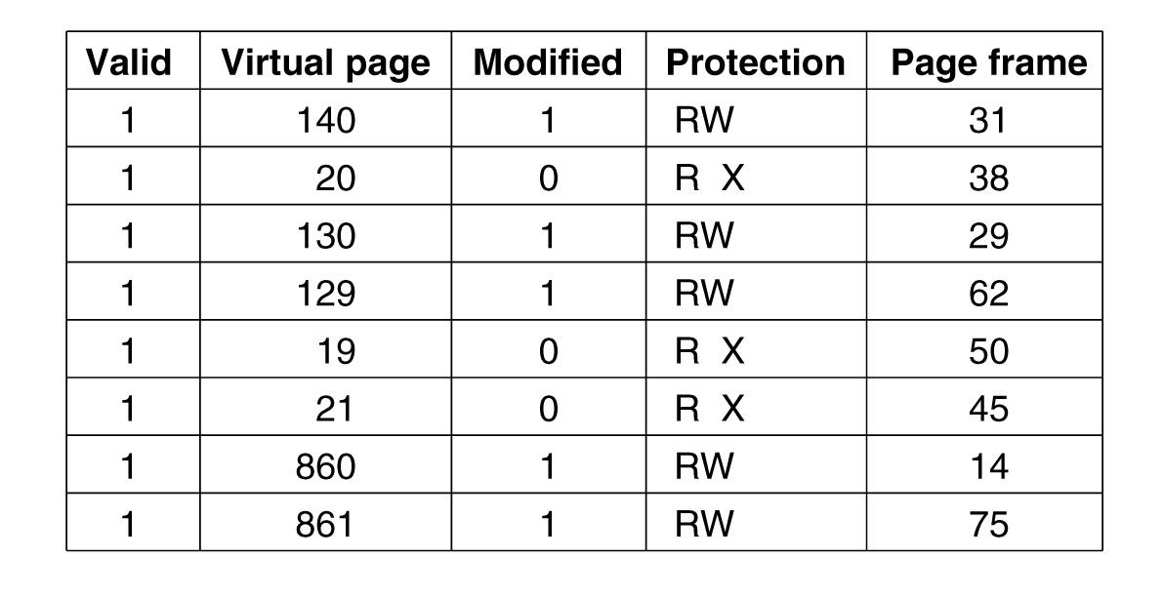
Translation Lookaside Buffers
Valid bit indicates whether page is in use or not
Tanenbaum, Modern Operating Systems 3 e, (c) 2008 Prentice-Hall, Inc. All rights reserved. 0-13-6006639

Slide 16
Translation Lookaside Buffer(TLB)
If address is in MMU, avoid page table
Uses parallel search to see if virtual page is in the TLB
If not, does page table look up and evicts TLB entry, replacing it with page just looked up
Tanenbaum, Modern Operating Systems 3 e, (c) 2008 Prentice-Hall, Inc. All rights reserved. 0-13-6006639

Slide 17
Software TLB management
Risc machines manage TLB in software
TLB fault processed by OS instead of by MMU hardware
Results less hardware in MMU and OK performance
Software can figure out which pages to pre-load into TLB (eg. Load server after client request)
Keeps cache of frequently used pages
Tanenbaum, Modern Operating Systems 3 e, (c) 2008 Prentice-Hall, Inc. All rights reserved. 0-13-6006639

Slide 18
Page Replacement Algorithms
If new page is brought in, need to chose a page to evict
Don’t want to evict heavily used pages
If page has been written to, need to copy it to disk.
Otherwise, a good copy is on the disk=>can write over it
Tanenbaum, Modern Operating Systems 3 e, (c) 2008 Prentice-Hall, Inc. All rights reserved. 0-13-6006639

Slide 19
Page Replacement Algorithms-the Laundry List
Optimal page replacement algorithm
Not recently used page replacement
First-in, first-out page replacement
Second chance page replacement
Clock page replacement
Least recently used page replacement
Working set page replacement
WSClock page replacement
Tanenbaum, Modern Operating Systems 3 e, (c) 2008 Prentice-Hall, Inc. All rights reserved. 0-13-6006639

Slide 20
Optimal Page Replacement
Pick the one which will not used before the longest time
Not possible unless know when pages will be referenced (crystal ball)
Used as ideal reference algorithm
Tanenbaum, Modern Operating Systems 3 e, (c) 2008 Prentice-Hall, Inc. All rights reserved. 0-13-6006639

Slide 21
Not recently used
Use R and M bits
Periodically clear R bit
Class 0: not referenced, not modified
Class 1: not referenced, modified
Class 2: referenced, not modified
Class 3: referenced, modified
Pick lowest priority page to evict
Tanenbaum, Modern Operating Systems 3 e, (c) 2008 Prentice-Hall, Inc. All rights reserved. 0-13-6006639

Slide 22
FIFO
Keep list ordered by time (latest to arrive at the end of the list)
Evict the oldest, i.e. head of the line
Easy to implement
Oldest might be most heavily used! No knowledge of use is included in FIFO
Tanenbaum, Modern Operating Systems 3 e, (c) 2008 Prentice-Hall, Inc. All rights reserved. 0-13-6006639

Slide 23
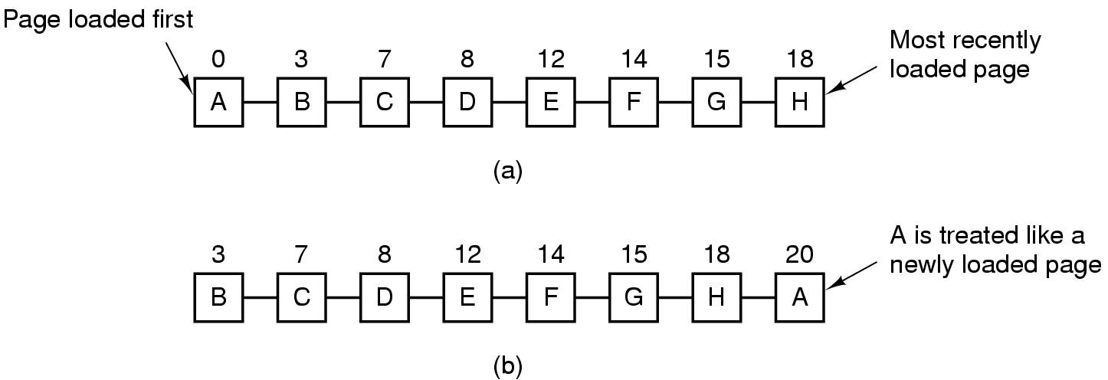
Second Chance Algorithm
Pages sorted in FIFO order by arrival time.
Examine R bit. If zero, evict. If one, put page at end of list and R is set to zero.
If change value of R bit frequently, might still evict a heavily used page
Tanenbaum, Modern Operating Systems 3 e, (c) 2008 Prentice-Hall, Inc. All rights reserved. 0-13-6006639

Slide 24
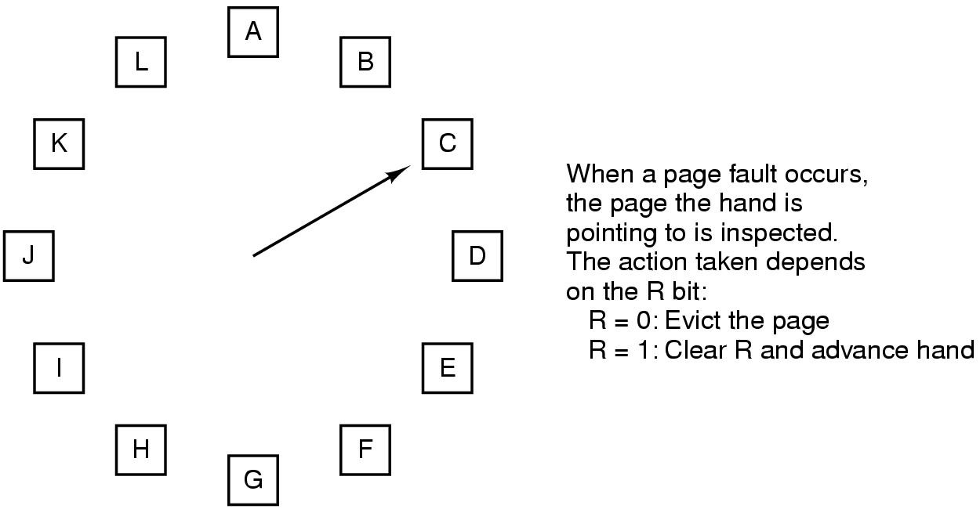
The Clock Page Replacement Algorithm
Tanenbaum, Modern Operating Systems 3 e, (c) 2008 Prentice-Hall, Inc. All rights reserved. 0-13-6006639

Slide 25
Clock
Doesn’t use age as a reason to evict page
Faster-doesn’t manipulate a list
Doesn’t distinguish between how long pages have not been referenced
Tanenbaum, Modern Operating Systems 3 e, (c) 2008 Prentice-Hall, Inc. All rights reserved. 0-13-6006639

Slide 26
LRU
Approximate LRU by assuming that recent page usage approximates long term page usage
Could associate counters with each page and examine them but this is expensive
Tanenbaum, Modern Operating Systems 3 e, (c) 2008 Prentice-Hall, Inc. All rights reserved. 0-13-6006639

Slide 27
LRU-the hardware array
Associate counter with each page.
At each reference increment counter.
Evict page with lowest counter
Keep n x n array for n pages.Upon reference page k, put 1’s in row k and 0’s in column k.
Row with smallest binary value corresponds to LRU page. Evict k!
Easy hardware implementation
Tanenbaum, Modern Operating Systems 3 e, (c) 2008 Prentice-Hall, Inc. All rights reserved. 0-13-6006639

Slide 28
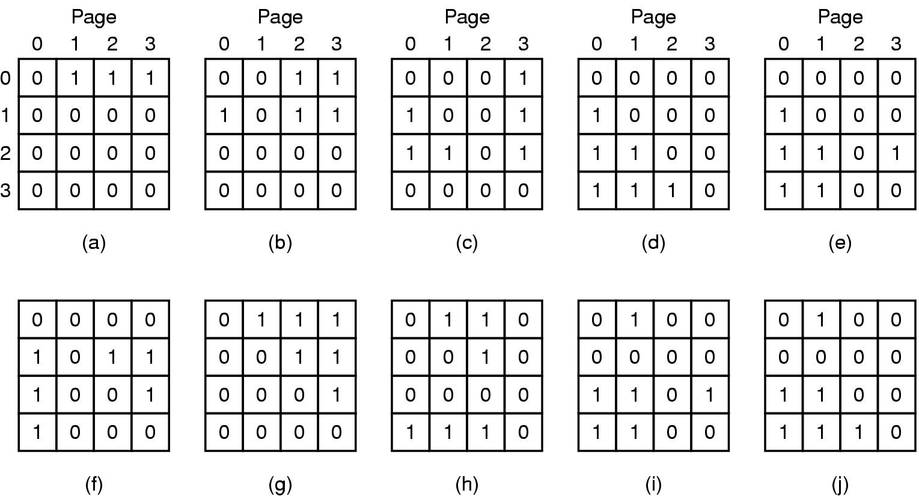
LRU-hardware
LRU using a matrix when pages are referenced in the order 0, 1, 2, 3, 2, 1, 0, 3, 2, 3.
Tanenbaum, Modern Operating Systems 3 e, (c) 2008 Prentice-Hall, Inc. All rights reserved. 0-13-6006639

Slide 29
LRU-software
Hardware uses space=> software implementation
Make use of software counters
Tanenbaum, Modern Operating Systems 3 e, (c) 2008 Prentice-Hall, Inc. All rights reserved. 0-13-6006639

Slide 30
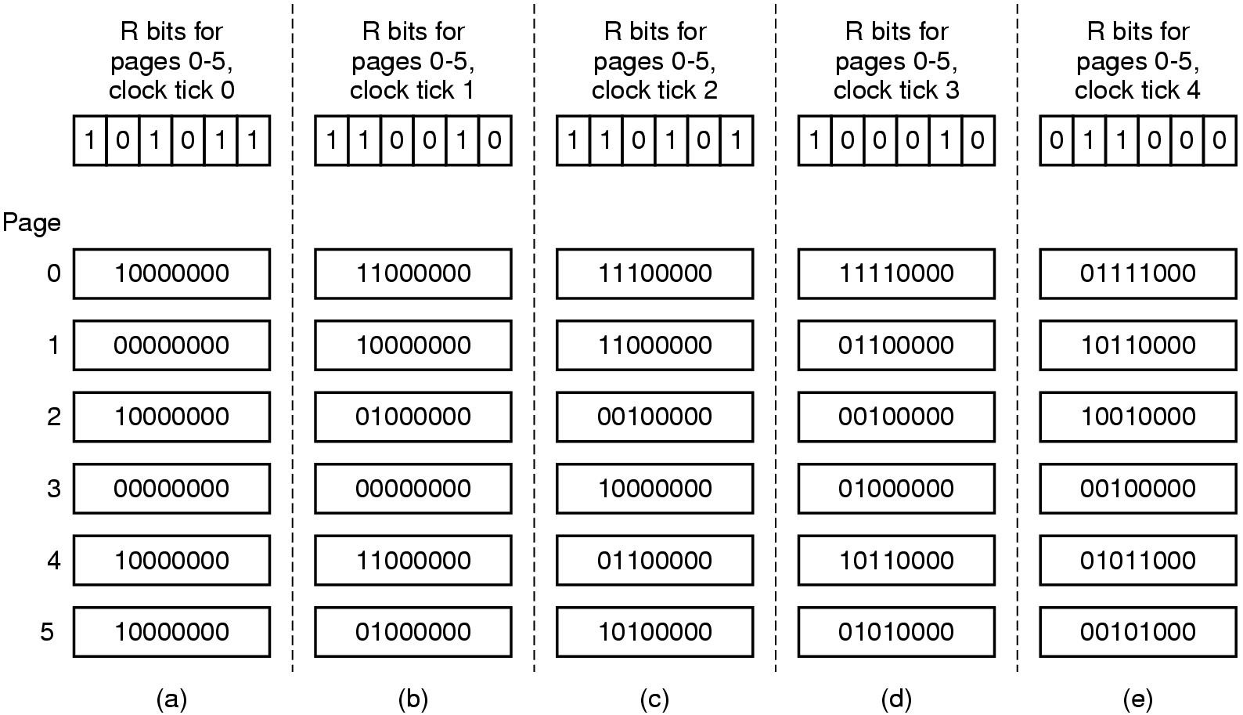
LRU in Software
Tanenbaum, Modern Operating Systems 3 e, (c) 2008 Prentice-Hall, Inc. All rights reserved. 0-13-6006639

Slide 31
LRU-software
“aging” algorithm
Keep a string of values of the R bits for each clock tick (up to some limit)
After tick, shift bits right and add new R values on the left
On page fault, evict page with lowest counter
Size of the counter determines the history
Tanenbaum, Modern Operating Systems 3 e, (c) 2008 Prentice-Hall, Inc. All rights reserved. 0-13-6006639

Slide 32
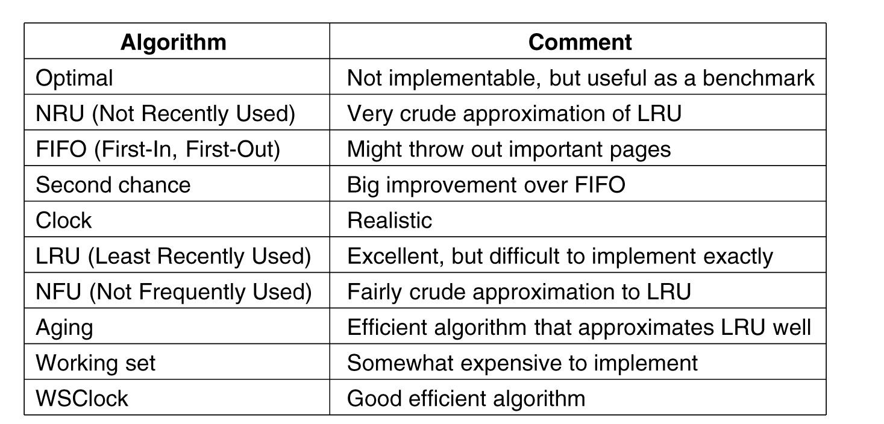
Summary of Page Replacement Algorithms
.
Tanenbaum, Modern Operating Systems 3 e, (c) 2008 Prentice-Hall, Inc. All rights reserved. 0-13-6006639

